Slide 1
Vocabulary in Context
How to hunt down the meaning of a word by using the clues around it
{Click mouse to continue}

Slide 2
How to Navigate Through a PowerPoint Workshop
This PowerPoint Presentation is designed to be experienced as a workshop. To ensure that you do not miss important information, only use your mouse at this prompt:
{Click mouse to continue}
{Click mouse to continue}

Slide 3
What is Vocabulary in Context?
Our Final Calculation:
Better Vocabulary Skills Which = Better Comprehension Which = Better Grades!
Lets break it into two parts
“Vocabulary”
(words in your text books)
+
“In Context”
(how those words relate to the words around them)
{Click mouse to continue}

Slide 4
How Does Vocabulary in Context work?
Most writers leave context clues as they write. It is our job as the reader to hunt them down!
You Follow The Clues
{Click mouse to continue}

Slide 5
Context Clues
There are 4 main types of Context Clues
The 4 Types
Rewording the word.
Giving its Synonym.
Giving its Antonym.
Giving us Details about the word.
{Click mouse to continue}

Slide 6
Context Clues: Rewording
Rewording is when the author says the word in another way, that is typically easier to understand.
{Click mouse to continue}

Slide 7
Context Clues: Rewording
Let’s Look at an Example:
, a feeling of bitterness and anger, is often felt by people who are passed over for promotions.
Resentment
What does the word resentment mean in this sentence?
{Click mouse to continue}

Slide 8
Context Clues: Rewording
Lets look at this sentence a little more closely for CLUES!
{Click mouse to continue}

Slide 9
Context Clues: Rewording
If you wanted to find the meaning of the word RESENTMENT the clue is right here.
Resentment, , is often felt by people who are passed over for promotions.
a feeling of bitterness and anger
Resentment is:
{Click mouse to continue}

Slide 10
Now You Give It A Try!
Context Clues: Rewording
The Cruise family moved from their house, that was old and run-down, into a brand new home.
dilapidated
What does the word dilapidated mean here?
HINT: In REWORDING, the context clues are often hidden between commas!
{Click mouse to continue}

Slide 11
Context Clues: Rewording
The Cruise family moved from their dilapidated house, that was , into a brand new home.
Dilapidated means
old and run-down
Did you find the Context Clue?
{Click mouse to continue}

Slide 12
Context Clues: Synonyms
A writer sometimes uses synonym context clues to help with hard words. A synonym context clue is one or two words that mean almost the same as the one that the author does not expect us to know.
{Click mouse to continue}

Slide 13
Context Clues: Synonyms
Let’s Look at an Example:
The young girl was very . She always seemed unsociable, unapproachable, and uninterested.
aloof
What does the word aloof mean in this sentence?
{Click mouse to continue}

Slide 14
Context Clues: Synonyms
All three of these words are synonyms to help us with the original word aloof
The young girl was very aloof. She always seemed
unsociable, unapproachable, and uninterested.
The word aloof means:
{Click mouse to continue}

Slide 15
Now You Give It A Try!
Context Clues: Synonyms
The three brothers began to
over the game.
This was not the first time that they had a dispute over it.
altercate
What does the word altercate mean here?
HINT: SYNONYM context clues are often hidden in surrounding sentences!
{Click mouse to continue}

Slide 16
Context Clues: Synonyms
The three brothers began to altercate over the game.
This was not the first time that they had a over it.
Altercate means the same as
dispute
Did you find any Context Clues????
{Click mouse to continue}

Slide 17
Context Clues: Antonyms
A writer is using antonym context clues when they use a word with opposite meaning to give us hints about the word that they don’t think we will know.
{Click mouse to continue}

Slide 18
Context Clues: Antonyms
Let’s Look at an Example:
Dianna appeared to be a very moral and upstanding young lady, but those who knew her knew that she was
iniquitous.
What does the word iniquitous mean in this sentence?
{Click mouse to continue}

Slide 19
Context Clues: Antonyms
The word BUT tells us that the two parts of the sentence represent opposite points of view about Dianna
There is a special word in this sentence that hints at the presence of an antonym.
Dianna appeared to be a very moral and upstanding young lady, those who knew her knew that she was iniquitous.
but
{Click mouse to continue}

Slide 20
Context Clues: Antonyms
The two opposite points of view are:
That Dianna is moral and upstanding.
That she is iniquitous
Dianna appeared to be a very
young lady, but those who knew her knew that she was
therefore means the opposite of
moral and upstanding
Iniquitous must mean evil and immoral
iniquitous
{Click mouse to continue}

Slide 21
Now You Give It A Try!
Context Clues: Antonyms
David was very outgoing as opposed to his older sister.
coy
What does the word coy mean here?
HINT: ANTONYM context clues always have hint words to tell us that there are opposites present!
{Click mouse to continue}

Slide 22
Context Clues: Details
A writer is using details as context clues when they give us explanations or examples as hints about the word that they don’t think we will know.
{Click mouse to continue}

Slide 23
Context Clues: Details
There are several different kinds of Context Clues that are Details.
Details that are examples of the unknown word.
Details that tell why the unknown word has taken place.
Details that explain how the word relates to other things the author has stated.
{Click mouse to continue}

Slide 24
Context Clues: Details
There is a special word in this sentence that hints at the presence of a detail.
The word BECAUSE tells us that the writer is about to say why Father was ecstatic.
Father was ecstatic
“Ecstatic” was how Father felt
Joshua decided to go to the college that he wanted him to.
because
Ecstatic must mean the same as happy!
{Click mouse to continue}

Slide 25
Now You Give It A Try!
Context Clues: Details
Brian was when he left the school building. He ran through the halls, jumped in his car, and sped off.
expeditious
What does the word expeditious mean here?
{Click mouse to continue}

Slide 26
Context Clues: Details
Did you figure out what types of details the writer is giving us about how Brian left school?
Brian was expeditious when he left the school building.
How did Brian leave?
He ran through the halls, jumped in his car, and sped off.
Expeditious Must Mean FAST!
{Click mouse to continue}

Slide 27
Context Clues: Review
Lets Review What We Have Learned
There are 4 main types of Context Clues
Rewording the word.
Giving its Synonym.
Giving its Antonym.
Giving Details about it.
{Click mouse to continue}

Slide 28
Context Clues: Practice
Now it is your turn to follow the clues!
The next few slides are sentences with context clues that you can hunt out on your own. Write down your answers as you go along.
{Click mouse to continue}

Slide 29
Context Clues: Practice #1
Mallery’s mom thought that the new outfit that she had bought for her was . Mallery did not want to break it to her, but it was totally out of style.
modish
Questions:
Which type of context clue is being used here?
What does the word modish mean in this sentence?
{Click mouse to continue}

Slide 30
Context Clues: Practice #2
Insomnia
, not being able to sleep at night, can be linked to an excessive intake of caffeine throughout the day.
Questions:
Which type of context clue is being used here?
What does the word insomnia mean in this sentence?
{Click mouse to continue}

Slide 31
Context Clues: Practice #3
The woman enjoyed the of the soup. It had a hint of spices balanced with the perfect amount of sweetness.
savor
Questions:
Which type of context clue is being used here?
What does the word savor mean in this sentence?
{Click mouse to continue}

Slide 32
Context Clues: Practice #4
The day had proven to be very . Before the sun had even risen, it was already hot outside.
torrid
Questions:
Which type of context clue is being used here?
What does the word torrid mean in this sentence?
{Click mouse to continue}

Slide 33
Context Clues: Practice #5
It is our custom that the bride and groom only wear the finest on their wedding day.
raiment
Questions:
Which type of context clue is being used here?
What does the word raiment mean in this sentence?
{Click mouse to continue}

Slide 34
Context Clues: Practice #6
Though many types of birds fly in groups, Eagles are birds of
solitude.
Questions:
Which type of context clue is being used here?
What does the word solitude mean in this sentence?
{Click mouse to continue}

Slide 35
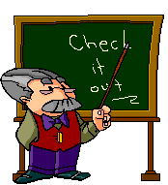
Context Clues: Practice
Now, lets see how you did!
{Click mouse to continue}

Slide 36
Context Clues: Practice Answer #1
This context clue was an Antonym. Here, modish means the same as stylish.
Mallery’s mom thought that the new outfit that she had bought for her was modish. Mallery did not want to break it to her, but it was totally out of style.
{Click mouse to continue}

Slide 37
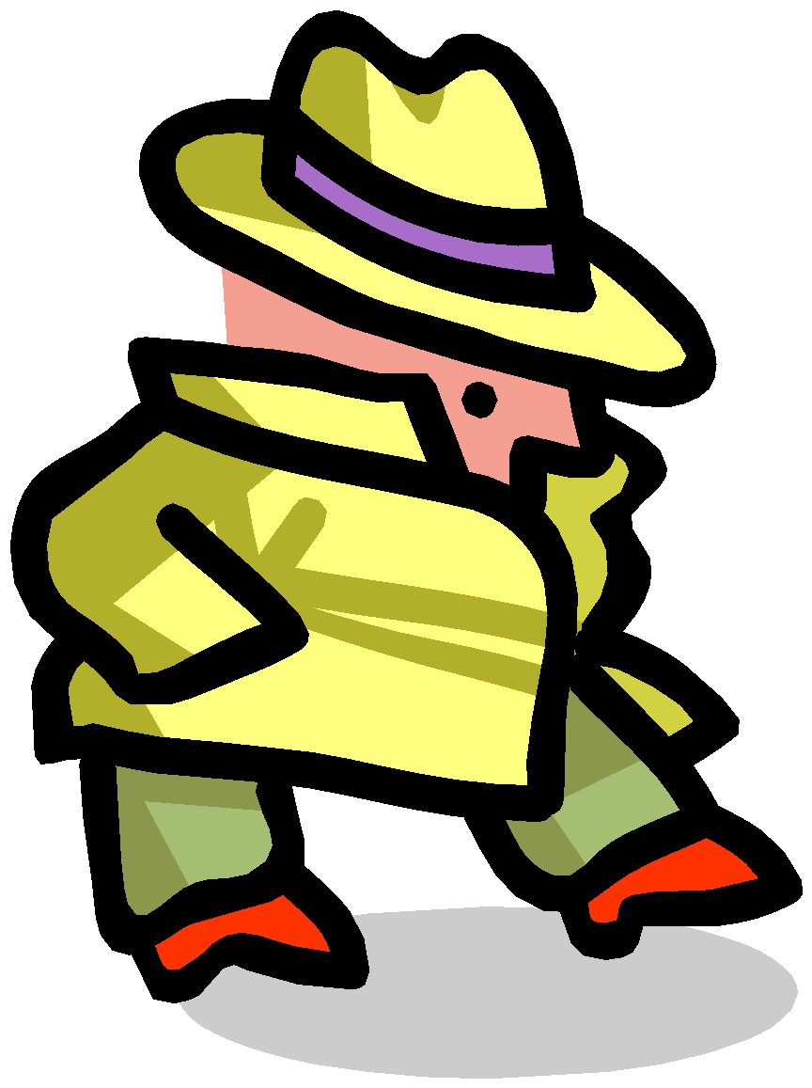
The context clue here was Rewording. Here, insomnia means not able to sleep at night.
Context Clues: Practice Answer #2
Insomnia, not being able to sleep at night, can be linked to an excessive intake of caffeine throughout the day.
{Click mouse to continue}

Slide 38
Context Clues: Practice Answer #3
This context clue was a Detail. Here, savor means the same as flavor.
The woman enjoyed the savor of the soup. It had a hint of spices balanced with the perfect amount of sweetness.
{Click mouse to continue}

Slide 39
Context Clues: Practice Answer #4
This context clue was a synonym. Here, torrid means the same as hot.
The day had proven to be very torrid. Before the sun had even risen, it was already hot outside.
{Click mouse to continue}

Slide 40
Context Clues: Practice Answer #5
This context clue was a Detail. Here, raiment means clothes.
It is our custom that the bride and groom only wear the finest raiment on their wedding day.
{Click mouse to continue}

Slide 41
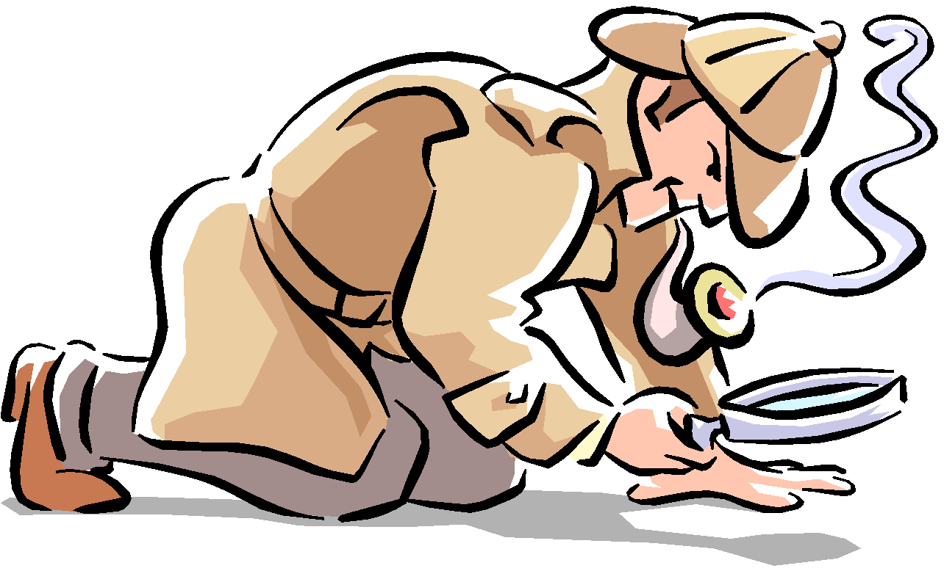
Context Clues: Practice Answer #5
Though many types of birds fly in groups, Eagles are birds of solitude.
This context clue was an antonym. Here, solitude means to be alone.
{Click mouse to continue}

Slide 42
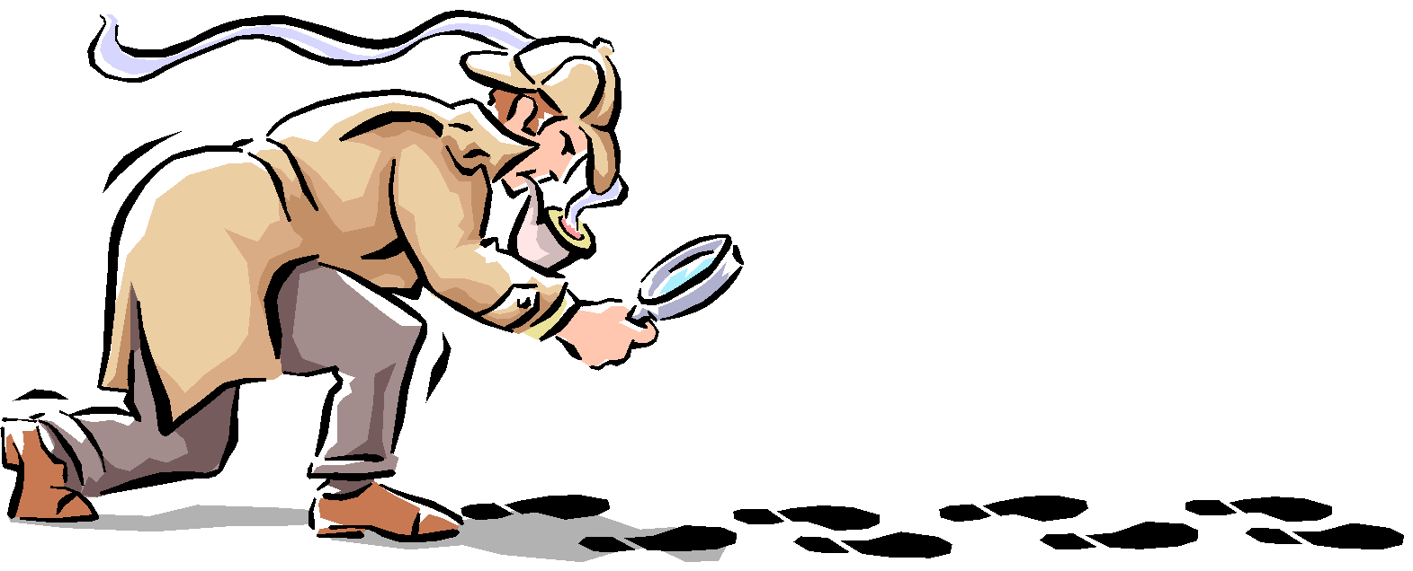
Job Well Done!
If you need more help with Vocabulary in Context, hunt us down on campus at:
The Learning Center
Room 100 Educational Services Building

